Slide 1
The Growth of a Data Scientist
我的資料科學之路
李 育 杰
Data Science and Machine Intelligence Lab
國立交通大學應用數學系
台灣資料科學年會
July 14-17, 2016

Slide 2
Big Data 3 V

Slide 3
台灣資料科學年會演講三要
要有趣
要有料
要有用

Slide 4
Agenda
From Data Mining to Big Data
Some my experiences in Data Science
Breast Cancer Diagnosis and Prognosis
Malicious URLs Detection
露天拍賣詐騙商品偵測
…
Final Remarks

Slide 5
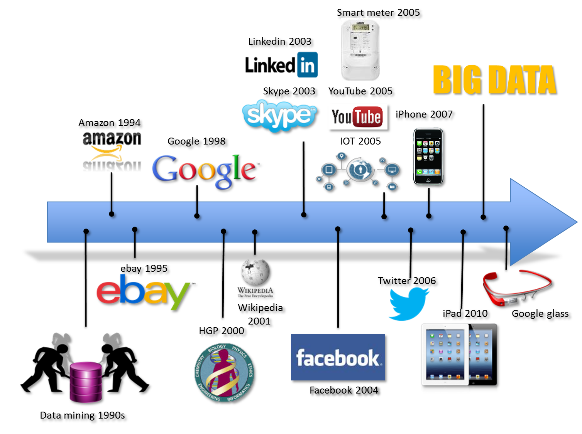

Slide 7
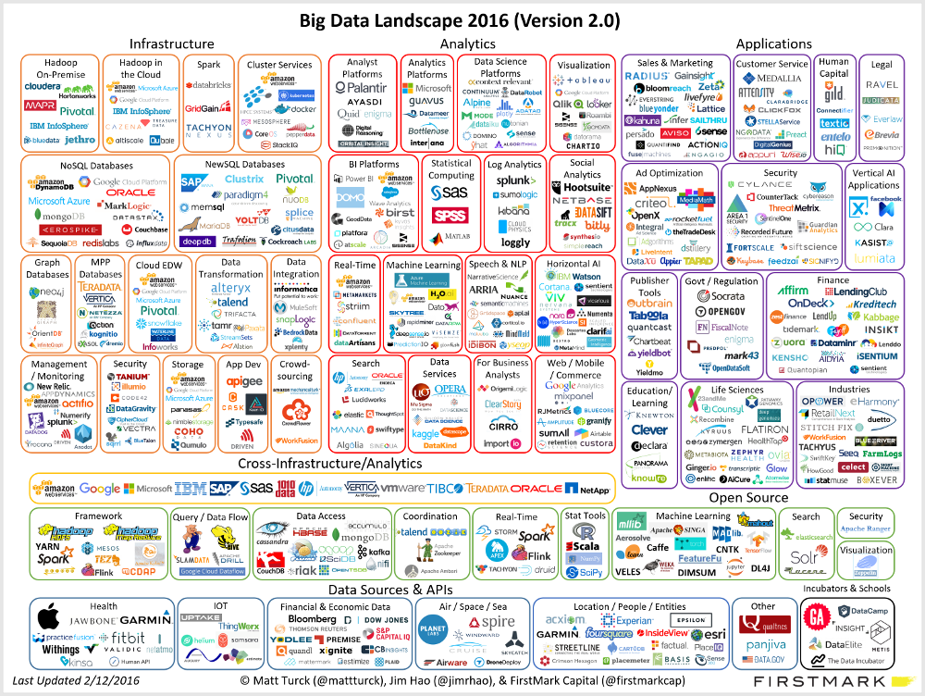

Slide 8
Breast Cancer Diagnosis and Prognosis

Slide 9
Cell Nuclei of a Fine Needle Aspirate 電子顯微鏡下的組織液細胞
Nuclear feature extraction for breast tumor diagnosis, WN Street, WH Wolberg, OL Mangasarian
IS&T/SPIE's Symposium on Electronic Imaging: Science and Technology, 861-870

Slide 10
從電子顯微鏡影像到細胞特徵

Slide 11
Breast Cancer Diagnosis via SVM 97% Ten-fold Cross Validation Correctness 780 Patients: 494 Benign, 286 Malignant

Slide 12
Who will be benefitted from Chemotherapy?

Slide 13
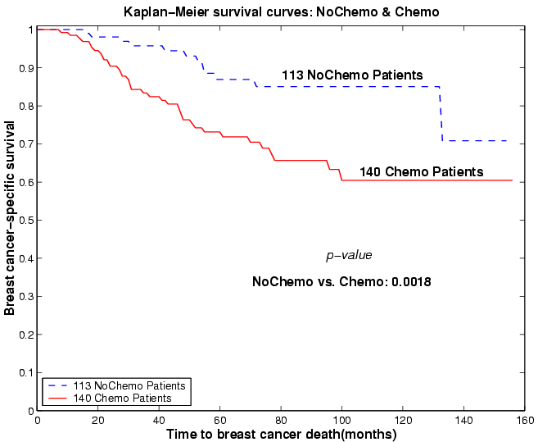
Survival Curves for Overall Patients: w./wo. Chemotherapy

Slide 14
Overall Clustering Process
253 Patients
(113 NoChemo, 140 Chemo)
Good1:
Lymph=0 AND Tumor<2
Compute Median Using 6 Features
Compute Initial
Poor1:
Lymph>=5 OR Tumor>=4
Compute Median Using 6 Features
Cluster Centers
Cluster 113 NoChemo Patients
Use k-Median Algorithm with Initial Centers:
Medians of Good1 & Poor1
Cluster 140 Chemo Patients
Use k-Median Algorithm with Initial Centers:
Medians of Good1 & Poor1
69 NoChemo Good
44 NoChemo Poor
67 Chemo Good
73 Chemo Poor
Good
Intermediate
Poor

Slide 15
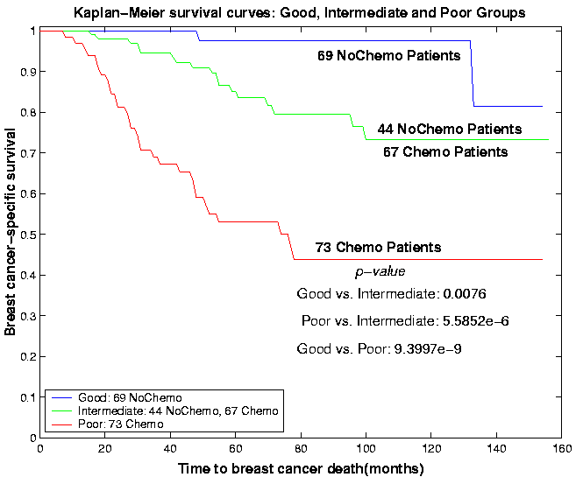
Survival Curves for Good, Intermediate & Poor Groups

Slide 16
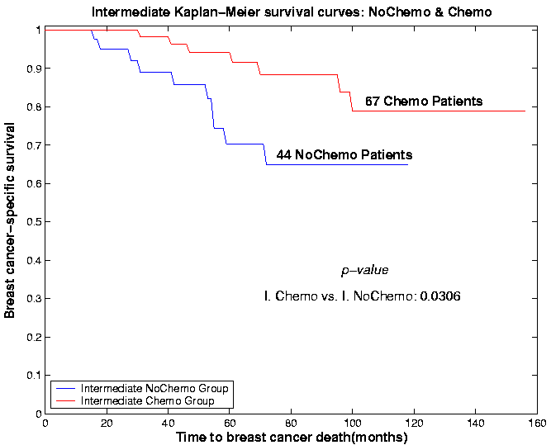
Survival Curves for Intermediate Group: Split by Chemo & NoChemo

Slide 17
The Lessons I Learned
Privacy is an issue
Working with domain experts is EXTREMELY important
Y2K
少也賤，故能多鄙事
Breast cancer survival and chemotherapy: a support vector machine analysis
YJ Lee, OL Mangasarian, WH Wolberg, Discrete Math. Problem with Medical Application,
DIMACS Workshop
Survival-time classification of breast cancer patients
YJ Lee, OL Mangasarian, WH Wolberg
Computational Optimization and Applications 25 (1-3), 151-166

Slide 18
Malicious URLs Detection
Can you filter out the benign URLs ONLY based on the URL stream?
Notes:
Social Engineering, Spam
Identity Fraud
Drive-by Download
Botnet, zombie network

Slide 19
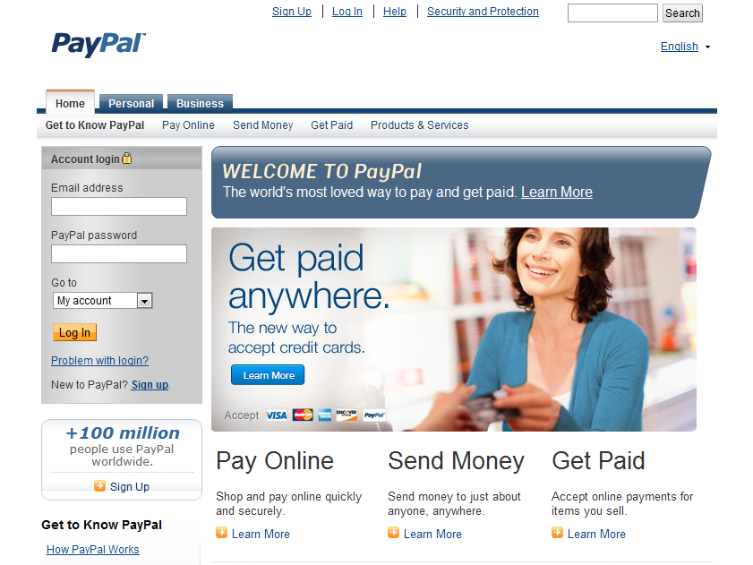
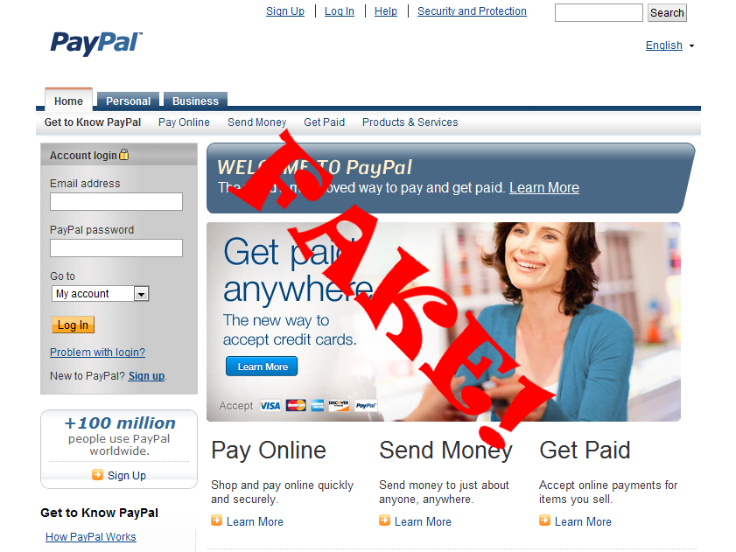
Malicious Websites
Malicious websites have become tools for spreading criminal activity on the Web
Phishing
Malware
(a) paypal.com
(b) paypal.com-us.cgi-bin-webscr...
Notes:
Social Engineering, Spam
Identity Fraud
Drive-by Download
Botnet, zombie network

Slide 20
Defences of Malicious URLs
Blacklist service
PhishTank
Spam and Open Relay Blocking System (SORBS)
Real-time URI Blacklist (URIBL)
Malicious URLs detection
Google
Google safe browsing
Trend Micro
Web Reputation Service
Notes:
Social Engineering, Spam
Identity Fraud
Drive-by Download
Botnet, zombie network

Slide 21
Why Need a Filtering Mechanism?
URL requests received from users all over the world
3,000,000,000 ~ 7,000,000,000 per day
200,000,000 ~ 800,000,000 need to be analyzed
Only 0.01% are malicious URLs
Filtering Mechanism
Notes:
Here need to emphasize the amount of requested URLs is too large to use the host-based information (whois information) or content information

Slide 22
Requirements from Industry
No page content need for prioritization
Prioritization means to return the most suspicious URLs
No host based information is allowed
Effectiveness
Filtering (Download) Rate = Filtered URLs/Total URLs < 25%
Malicious Coverage = Filtered Malicious URLs/ Total Malicious URLs > 75%
Performance – Filtering
> 2000 URLs per second for 1 dual-core VM with 4GB memory.
Scalability
One hour data should be consumed in one hour
Notes:
Here need to emphasize the amount of requested URLs is too large to use the host-based information (whois information) or content information

Slide 23
Big Challenges
Large scale data streaming
One million URLs will be received per hour in average
High dimension and sparse presentation
Lexical information makes feature vector to become very sparse
Extremely imbalanced data set
Only contains about 0.01% malicious URLs
Malicious URLs usually have very short life time
Notes:
Normal URL stand for a longer time for usability
This page should emphasize the 3 Vs

Slide 24
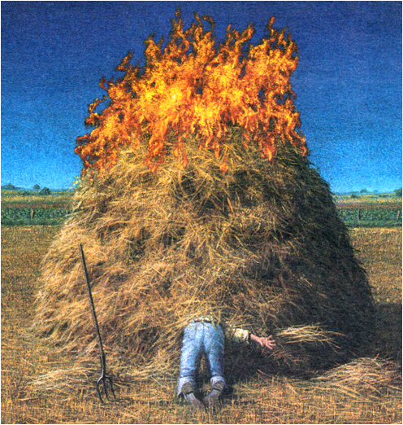
Finding a Needle in a Haystack
Notes:
Normal URL stand for a longer time for usability
This page should emphasize the 3 Vs

Slide 25
Our Main Results
Malicious URLs Covering Rate
90%
75%, requirement
25%, if uniformly random
Filtering Rate ≈ False Positive Rate
Notes:
Normal URL stand for a longer time for usability
This page should emphasize the 3 Vs

Slide 26
Feature Extraction
Limitations: Can not use
Host-based information
Web page content information
Two types of feature sets are proposed
Lexical features
Descriptive features
Notes:
Two type of feature sets are proposed as different views for inspecting received URL

Slide 27
Lexical Features: Information of Words
The words in a URL string are translated into a Boolean vector
Each Boolean value represents the occurrence of specific word
Each URL component is split by specific delimiters and the words will be saved in a dictionary

Slide 28
Lexical Features (cont.)
Three character length sliding window on the domain name
For the malicious websites which slightly modify its domain name
For reducing memory usage of dictionary:
Remove zero-weight words
Remove word form argument value
Replace IP with AS number (Using static mapping table)
Replace the digits in word with regular expression
Example: replace cool567 to cool[0-9]+
Keep the words generated in the last 24 hours only

Slide 29
Descriptive Features: Static Characteristics of URL String
Descriptive features observed from malicious websites
For detecting the phishing websites
A Digit between Two Letters (LDL)
Examp1e
A Letter between Two Digits (DLD)
award2o12
For detecting malware website
Executable File or Not
Notes:
Descriptive features are not easily changed by modifying the URL.

Slide 30
Descriptive Features (cont.)
Fraction of domain name
Categorizing characters to letters, digits and symbols
Splitting domain name by the connection of different categories
Summing of longest token length of each category and divides by the domain name length

Slide 31
Descriptive Features (cont.)
For detecting randomly generated string
Alphabet Entropy
Number Rate
For detecting abnormal phenomenon in URL string
Length
Length Ratio
Letter, digit and symbol count.
For detecting the common way on URL
Using IP as Domain Name
Default Port Number
For covering the Sparse Features
Delimiter Count
The Length of Longest Word

Slide 32
Collaborative Filtering Models
We choose two online learning algorithms to update the model for
Saving processing time and memory usage
Adjusting model from concept drift of data streaming
Two prospects of features to build two filters
For descriptive features
Passive-aggressive algorithm
For lexical features
Confident weighted algorithm
Over-sampling technique for extremely imbalanced data set
Notes:
The online learning algorithm is a memory-efficient machine learning algorithm
Different with batch learning, online learning algorithm doesn't need to keep old instances in memory for training.
Usually be used in the large-scale problem

Slide 33
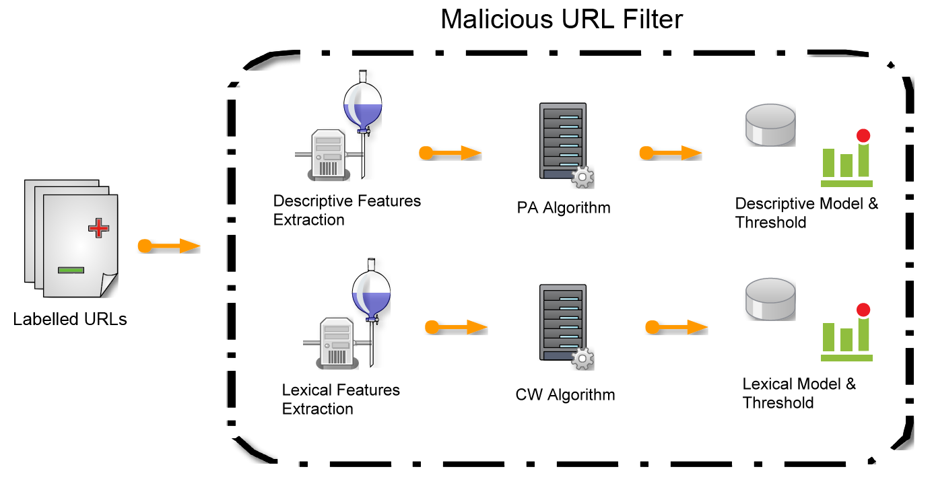
Training Process

Slide 34
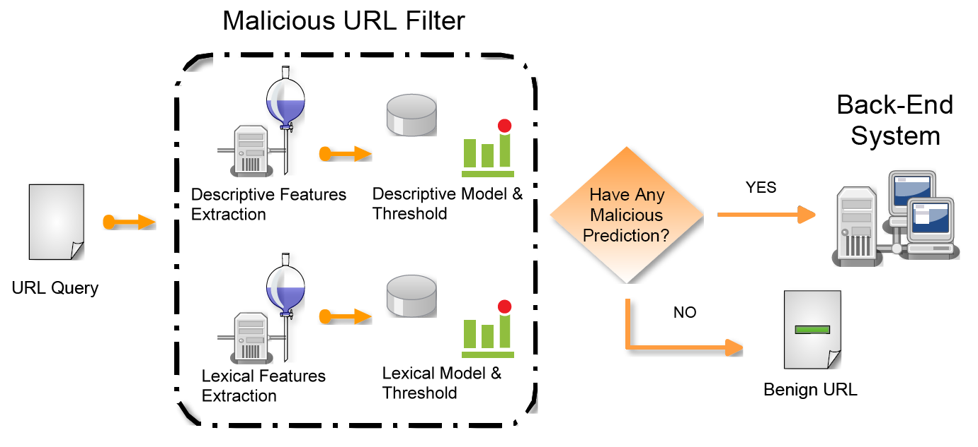
Prediction Process

Slide 35
Evaluation
Data Set
Measure
Download Rate (DR)
(TP + FP) / # of instances
Missing Malicious Rate (MMR)
FN / (TP + FN)

Slide 36
Evaluation: Efficiency
Environment
CPU : Dual-core (3.00GHz)
Memory : 4GB OS : Cent OS 64 bit
Results
Notes:
For the security company,
They use Intel(R) Xeon(TM) CPU 3.00GHz, 8 cores
And they consumed 200~400 MB memory (so do we, depends on the dictionary size)
With this environment, they can deal with:
Average samples per hour: 1.6 million, about 10% of total traffic, takes 21.5 min on average
And their results are all around 30% (both DR & MMR)

Slide 37
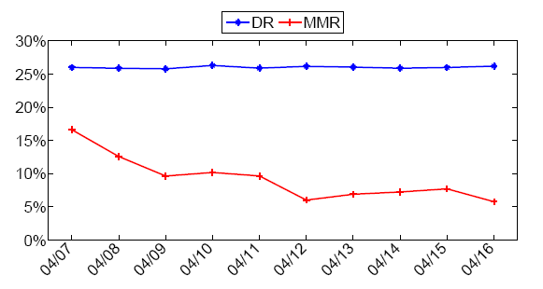
Evaluation: Performance
Settings
Use one hour data for training/updating
Predict next hour and record the results
Compute the daily average of DR & MMR
Apr.

Slide 38
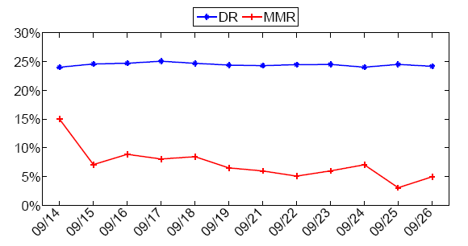
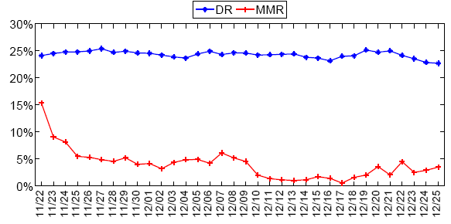
Evaluation: Performance
Sep.
Nov.-Dec.

Slide 39
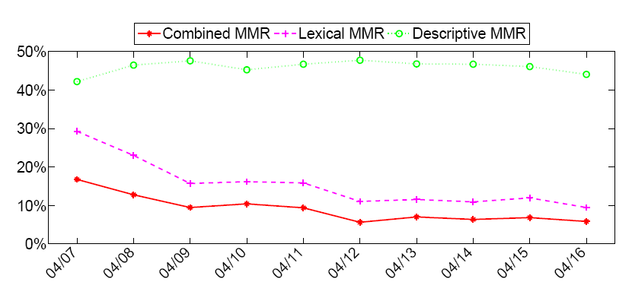
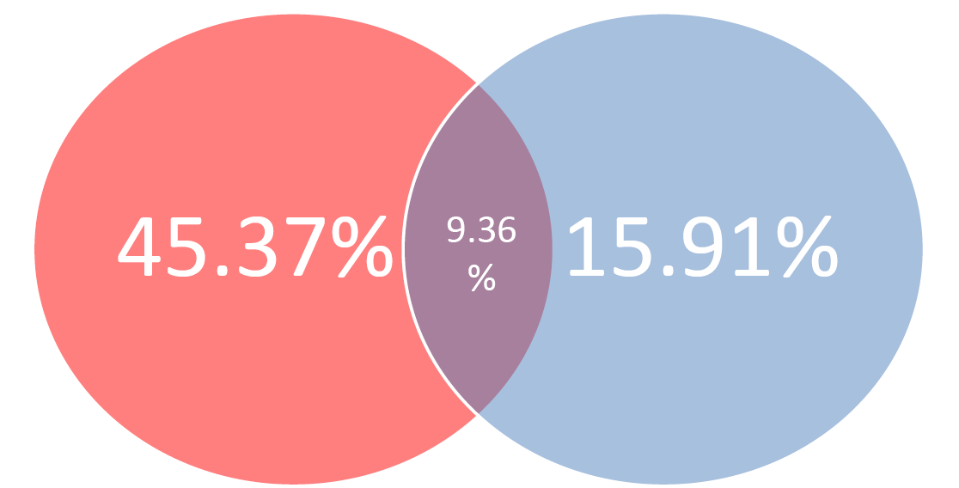
Why Collaborative Filtering Works?
Both of two filters have a certain accuracy
However, their results are different
Set the download rate for each filter around 10%
Apr.
Average MMR of Descriptive Filter
Average MMR of Lexical Filter

Slide 40
The Lessons I Learned
How to convert URLs stream into n-dimensional vector space
How to deal with extremely unbalanced data
Brain storming to define and extract features
Choose a right learning algorithm
How to deal with industry
Malicious URL filtering -A big data application
MS Lin, CY Chiu, YJ Lee, HK Pao, Big Data, 2013 IEEE International Conference on, 589-596

Slide 41
露天拍賣詐騙商品偵測

Slide 42
露天個案研究
利用機器學習輔助審查人員偵測詐騙商品

Slide 43
露天 is the Top 1 in Shopping Category

Slide 44
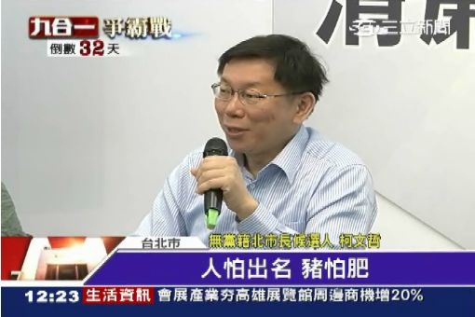
Notes:
人怕出名豬怕肥
露天這麼厲害一定也會有麻煩找上門

Slide 45
詐騙事件層出不窮
Notes:
沒錯
露天就成為詐騙集團的下手目標

Slide 46
165 警政署高風險場排行榜
104年1至12月前10名高風險賣場 165警政署統計資料
排名 | 賣場名稱 | 總件數
1 | 露天拍賣 | 1418
2 | 86 小舖 | 824
3 | SHOPPING99 | 804
4 | 奇摩拍賣 | 674
5 | HITO本舖 | 592
6 | 小三美日 | 462
7 | 金石堂網路書店 | 368
8 | 衣芙日系 | 349
9 | 奇摩超級商城 | 317
10 | 樂天 | 217

Slide 47
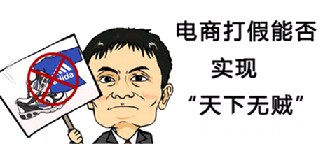
網路電商都要打假、防詐騙

Slide 48
露天有甚麼機制防範詐騙?
Notes:
那露天有沒有什麼機制去防範詐騙發生?
有的

Slide 49
Notes:
在露天上架時所有商品會經過一個篩選機制被選到的商品會通過審核人員的審核
進入到商品頁面的商品如果有善心人士發現是可疑的詐騙商品就可以在商品頁面上檢舉或是直接到客服頁面檢舉
由客服來下架可疑詐騙商品
或是如果不幸有詐騙商品流到商品頁面騙到消費者
消費者也可以檢舉讓客服處理
所以在這個環節中最重要的就是這個篩選機制

Slide 50
檢測專家遇到的挑戰
上架商品數量百萬等級
如果24小時全年無休一個人一秒看一個商品也要十個人才能消化每天全部上架的商品

Slide 51
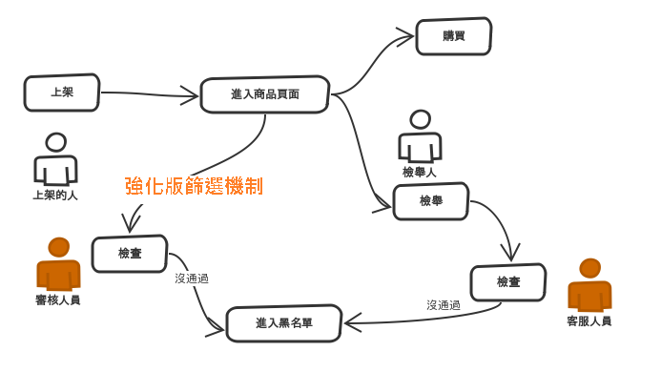
如何聰明地篩選需檢查的商品?
Machine Learning
Notes:
所以我們需要一個強化版的篩選機制

Slide 52
Major Challenges
極端不平衡的資料
好人佔大多數極少數壞人
但壞人會上傳大量詐騙商品
詐騙集團策略會改變
詐騙商品的多樣性
詐騙商品會隨季節流行改變
收集與前處理資料困難
釐清需要甚麼資料
需要的資料散佈在不同資料來源
露天傳統資料儲存系統無法滿足所需操作
資料量龐大
每天有百萬級商品上傳
需要即時性處理
Notes:
但事情沒像想像中那麼簡單

Slide 53
Get your Hands Dirty
訪談審核人員、確認SOP
確認所需資料來源
確認資料流
從不同資料來源中萃取有用資料
從審核人員累積的 (Label) 資料中建模

Slide 54
審核專家經驗 – 帳號
帳號
re9n6LG0
4JEMxCRFwW
jiJo4tpK
7FCXfrgO
2Ntla
5YsJSafSg8
jcshgx
12pm1c
以使用者帳號為例，詐騙集團假冒正當賣家的方式
當露天帳號申請門檻不高時，詐騙集團會大量申請殭屍帳號，帳號通常會像亂數，由程式產生
經由各種手段盜用正常使用者帳號，被盜用的使用者通常為長久無使用的帳號，所以可比對最後一次登入日期與上架日期判定

Slide 55
審核專家經驗 – 付款方式與地點
以商品所在地為例詐騙集團避免面交所以常常把商品所在設在較偏遠地區
也不喜歡貨到付款這種付款方式
ip 該如何使用?

Slide 56
確認資料來源與資料流

Slide 57
系統架構
用戶特徵、商品特徵
原始資料庫鏡像
用戶畫像
額外應用
預測模型
露天主要資料庫
Log檔案
Labeling
檢測專家

Slide 58
如何看一件商品?

Slide 59
Data Set
Training set: (251827, 20)
Testing set: (109122, 20)
上架日期 | 商品類別 | 商品數目 | 付款方式 | 商品價格 | 商品地點 | 商品運送方式 | 上架方式 | 使用者帳號 | 有無認證 | ip | 上次上架日期 | 是否第一次上架
1467043200 | 生活、居家 | 999 | 信用卡 | 520 | 台南市 | 7-11取貨 | 單品上架 | xxxxx | 有 | xxx.xx.xxx.xxx | 2016-06-27 23:59:59 | N
1467043200 | 手機、通訊 | 999 | 支付連 | 1461 | 台北市 | 7-11取貨 | 單品上架 | xxxxxxx | 無 | xxx.xx.xxx.xxx | 2016-06-27 23:59:59 | N
1467043200 | 休閒旅遊 | 50 | 貨到付款 | 19 | 台南市 | 貨到付款 | 單品上架 | xxx | 有 | xx.xxx.xxx.xxx | 2016-06-27 23:59:23 | N
Notes:
實際數據如下
為何最後會選擇LR是因為我們實驗過後發現LR的效果最好

Slide 60
Leading Board
AUC

Slide 61
Competition Results
Model
Logistic Regression
SVM
Gradient Boost Decision Tree
Naïve Bayes
Training time: 5~10 min
Testing time: 1~2 min

Slide 62
從工人智慧到人工智慧
審核人員僅能檢查相對少數的資料，即使焚膏繼晷
Sampling scheme 造成漏網之魚
數個月下來，累積的Labelled Data，應該發揮功用!
We used these labelled data as the “ground truth”
Our model can achieve 0.983 AUC
1,000 items can be examined in a second
There is a hope to examine EVERY item

Slide 63
Keep the Experts in the Loop
審核人員對我們依然重要!
We use our model to rank the “suspicious level” of item
We can let 審核人員 examine the “gray” items
Get the new labelled items from 審核人員
We can re-train our model with new labelled data
Tango with bad guys

Slide 64
Data Science Team in Ruten
We are hiring!

Slide 65
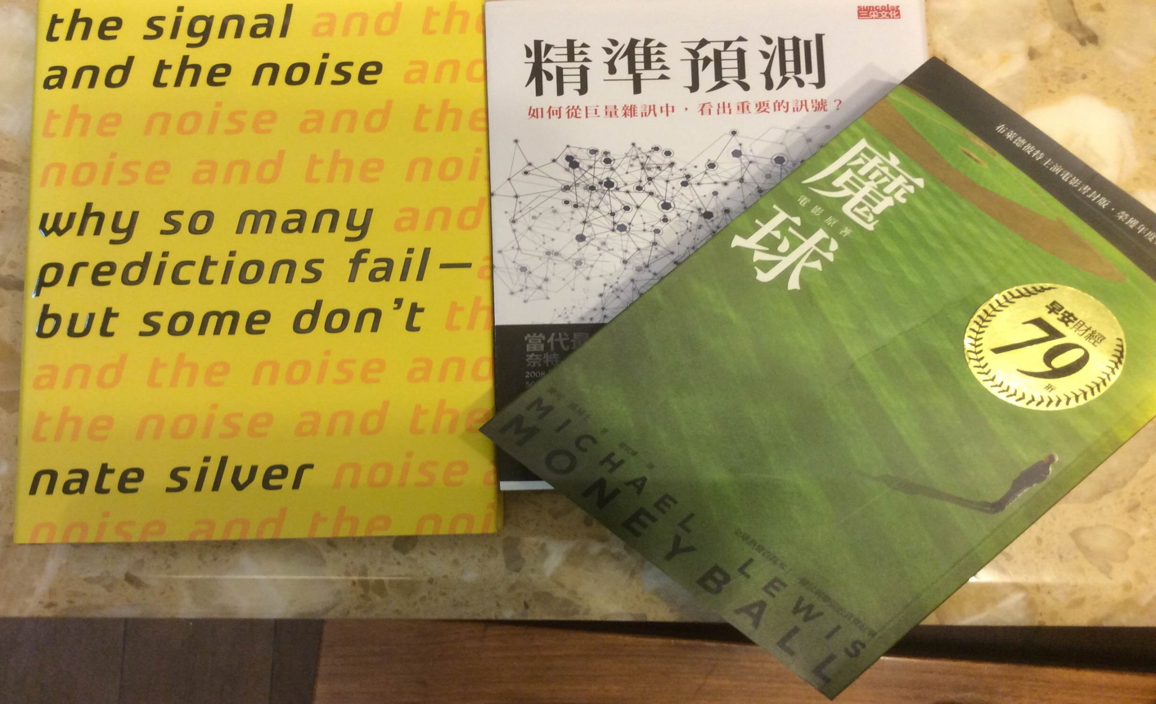
Strongly Recommend Books

Slide 66
Final Remarks
If you torture the data long enough, it will confess to anything -Ronald H. Coase
You data analytics results can not be beyond the nature rules
Working with domain experts is very important
Knowing the algorithms you used
Be eager for data

Slide 67
Questions?

Slide 68
Thank You!

Slide 69
Social Network Services Part of Data Source from Cyberspace

Slide 70
Your Smart Home Part of Data Source from Physical World
I am watching you!
Notes:
http://couturedigital.com/Wordpress/wp-content/uploads/2011/03/23-Zone-Smart-Home-Hertfordshire.jpg

